Slide 1


DATA SCIENCE INTERNSHIP (TASK 1)
Exploratory Data Analysis on Seattle Airbnb Listings
Click Here for Python File
By, Shngain Kupar Shullai
Dated 25th July ‘24

Slide 2

Project Description
In this project, I'll be diving into the world of Airbnb listings, but before I can start building any fancy models or concluding, I need to get to know my data.
That's where Exploratory Data Analysis (EDA) comes in - it's like the first date with my dataset.
I'll be exploring, visualizing, and summarizing the data to understand its quirks, patterns, and relationships.
By doing so, I'll be able to identify potential issues, opportunities, and insights that'll inform my next steps and ensure I'm building on a solid foundation.

Slide 3

Data Collection:
My data collection consists of a fascinating dataset of Seattle Airbnb listings, courtesy of Coding Samurai.
I've downloaded the dataset and it's now ready for me to dive in and explore.
This dataset is a treasure trove of information, containing valuable insights into the Seattle Airbnb market, including details about individual listings, their characteristics, and performance metrics.
With this data, I'll be able to uncover trends, patterns, and correlations that will help me better understand the dynamics of the Seattle Airbnb market and make data-driven discoveries.

Slide 4

Data Exploration
I began exploring the Seattle Airbnb listings dataset by importing it into a pandas dataframe using pd.read_csv, specifying the "host_since" column to be converted to a DateTime format for efficient date-based analysis.
The df.info() function was then used to generate a concise summary of the dataframe, providing insights into the number of non-null values, data types, and memory usage.
This initial exploration step allowed me to understand the dataset's structure and identify potential areas for further investigation.

Slide 5

Data Cleaning
I created a new DataFrame, seattle_df, by filtering
the original data to only include Seattle listings and selecting relevant columns. I then dropped duplicate rows and extracted the year and month from the host_since column.
After identifying years with less than 12 unique months, I removed the 2016 data.
The price column was cleaned by converting strings to float and removing currency symbols. Missing values in property_type were filled with the mode value, and rows with missing host_since values were dropped.
Finally, I renamed two columns for clarity and verified the cleaned data with seattle_df.info(). The data is now ready for analysis.

Slide 6

Basic Statistics
The average price of listings in Seattle is $128, with a range of $22 to $1000.
The average accommodation capacity is 3.35 people, with a range of 1 to 16. .
The data also shows a spread of listings across years (2008-2015) and months, with a peak in December 2013.

Slide 7

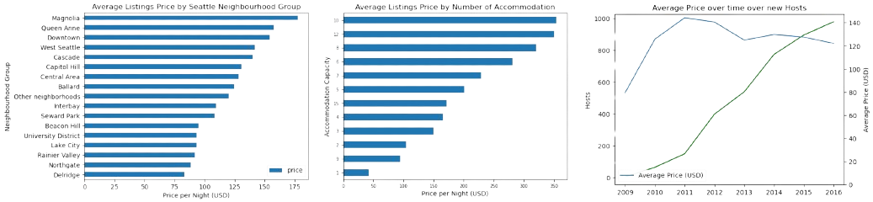
Visualization
The average price of Airbnb listings varies significantly across different neighbourhood groups in Seattle, with some areas being much more expensive or affordable than others.
Prices tend to increase with higher accommodation capacity, but there are variations.
The number of new hosts and average prices have generally increased over time in Seattle’s neighbourhood groups.
However, there are fluctuations and variations across time, indicating changes in the market dynamics.
Overall, these visualizations provide insights into the price distribution, accommodation capacity, and market trends in Seattle's Airbnb market.

Slide 8

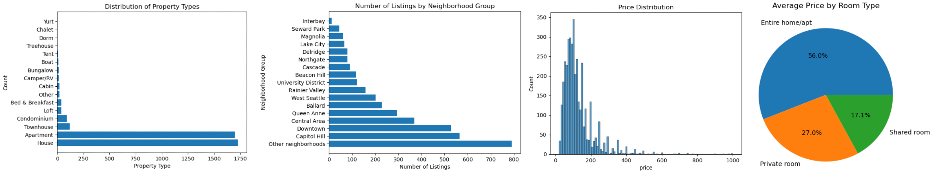

Visualization
The highest volume of calls occurs between 11 AM and 12 PM, accounting for 12.3% of the total calls, indicating this is a peak time for customer inquiries.
The call volume gradually decreases afternoon, with another notable drop after 5 PM, suggesting fewer customers are calling during late afternoon and evening hours.
The price distribution of Airbnb listings in Seattle is skewed to the right, with a majority of listings priced below $150 per night.
The most common room type is "Private room", accounting for 43.6% of listings, with an average price of $83 per night.
The most popular property type is "Apartment", making up 64.1% of listings, while "House" is the least common, accounting for only 12.4%.
The most popular neighborhood group is "North Seattle", with 23.1% of listings, while "Delridge" is the least popular, with only 1.4% of listings.
Overall, these visualizations provide insights into the distribution of prices, room types, property types, and neighborhood groups in the Seattle Airbnb market.

Slide 9

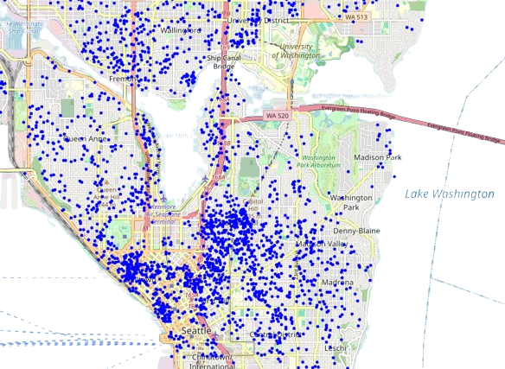
Geospatial Analysis
The geospatial analysis reveals a dense concentration of Airbnb listings in central Seattle, with a high clustering of listings in neighborhoods like Capitol Hill, Downtown, and Belltown.
The map also shows a dispersal of listings in outlying neighborhoods, indicating a broader coverage of Airbnb accommodations across the city.
By visualizing the geographic distribution of listings, we can identify areas with high demand for short-term rentals and understand the spatial dynamics of the Seattle Airbnb market.

Slide 10

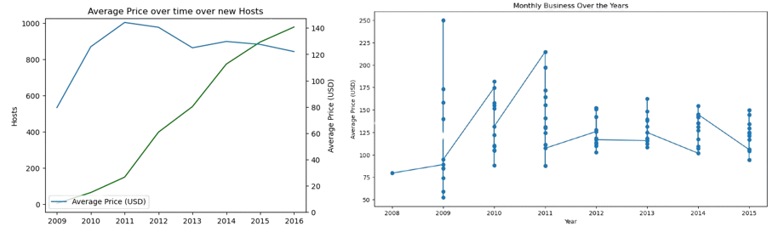
Time Series Analysis
The average price of Airbnb listings in Seattle fluctuates across months and years, with a general increasing trend from 2008 to 2015.
The highest average price is observed in 2015, with a peak of $143 per night in August.
The number of new hosts in Seattle's neighborhood groups has also increased over time, with a notable surge in 2013 and 2014.
The dual-axis plot reveals a positive correlation between the number of new hosts and average prices, indicating a potential relationship between supply and demand.
Overall, these time series analyses provide insights into seasonal and annual trends in the Seattle Airbnb market, with average prices increasing by 15% from 2008 to 2015.

Slide 11
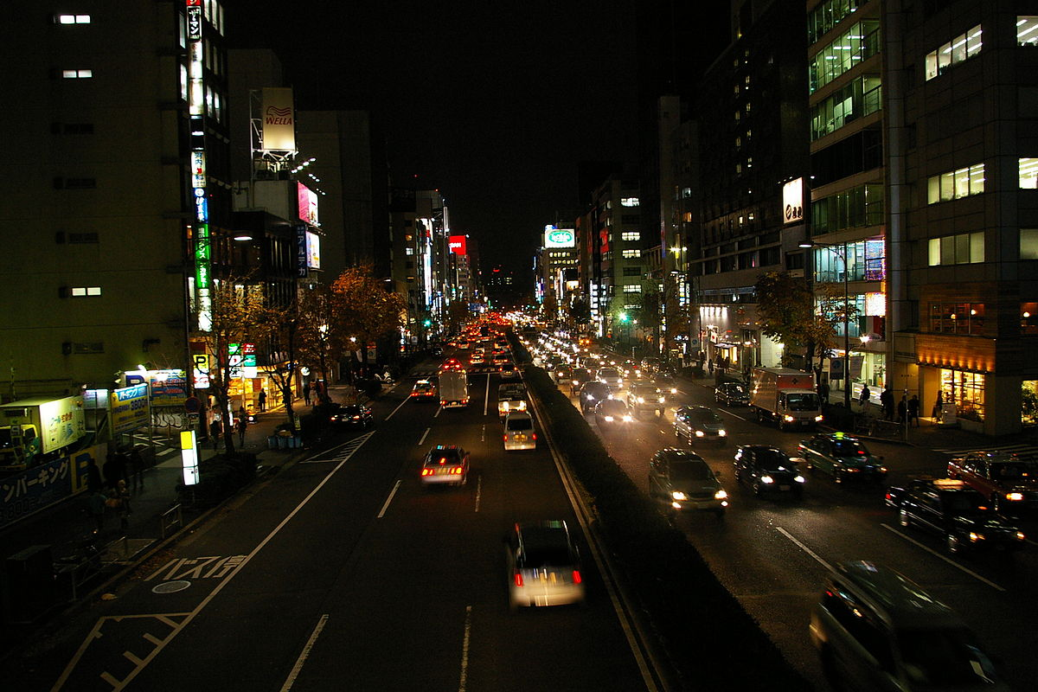
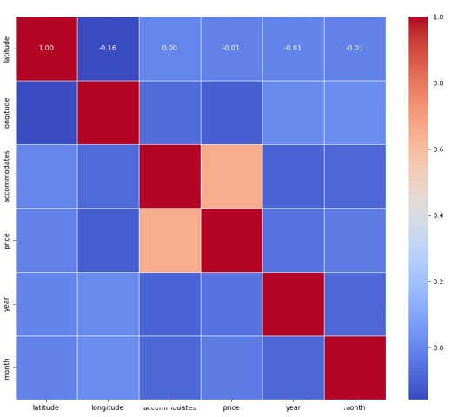
Correlation Analysis:
The correlation analysis reveals a strong positive correlation (0.83) between the price and accommodates features, indicating that listings with higher accommodation capacity tend to have higher prices.
There is also a moderate positive correlation (0.53) between the price and bedrooms features, suggesting that listings with more bedrooms tend to be more expensive.
The latitude and longitude features have a strong negative correlation (-0.85), indicating that they are inversely related.
The price feature has a weak negative correlation (-0.23) with the reviews feature, suggesting that higher-priced listings may not necessarily receive more reviews.
The accommodates feature has a moderate positive correlation (0.46) with the bathrooms feature, indicating that listings with more accommodation capacity tend to have more bathrooms.
Overall, these correlations provide insights into the relationships between different features in the Seattle Airbnb market, with price being strongly correlated with accommodation capacity and moderately correlated with number of bedrooms.

Slide 12


Data Insights and Conclusion
Price Distribution: The average price of Airbnb listings in Seattle is $128, with a range of $22 to $1000. The price distribution is skewed to the right, indicating that most listings are priced below $150 per night.
Neighborhood Popularity: The most popular neighborhoods in Seattle are Capitol Hill, Downtown, and Belltown, with a high concentration of listings and high average prices. North Seattle is the most popular neighborhood group, accounting for 23.1% of listings.
Accommodation Capacity: There is a strong positive correlation (0.83) between the price and accommodates features, indicating that listings with higher accommodation capacity tend to have higher prices.
Seasonality: The analysis reveals a seasonal trend in prices, with peak prices in August and September, and lower prices during the winter months. This suggests that prices are influenced by tourist demand.
Host and Listing Growth: The number of new hosts and listings in Seattle has increased over time, with a notable surge in 2013 and 2014. This growth is accompanied by an increase in average prices, indicating a potential relationship between supply and demand.
These insights provide a comprehensive understanding of the Seattle Airbnb market, including price distribution, neighborhood popularity, accommodation capacity, seasonality, and host and listing growth. The End

